Slide 1


Slide 2


THE GOSPEL Step 1
BRIDGE QUESTIONS
Where do you find your meaning and value
to feel good about yourself?
Performance?
Work?
Spouse?
Friends?
Boyfriend?
Good Looks?
Money?
Past?
Ministry?
Other People’s Opinions?
Kids?
What does that mean to you?
Why does that bother you?

Slide 3
THE GOSPEL Step 1
SAMPLE BRIDGE QUESTIONS
What does that mean to you? Why does that bother you?
What is most important in your life? OR Is _________ the most important thing in your life?
Where do you find your meaning or significance? OR Is __________ where you find your meaning?
Are there risks in finding your meaning in ______________?
How does your faith relate to the circumstance you are going through….or does it?
If _______ was not the center of your life, do you think it would help you or hurt more?

Slide 4
THE GOSPEL Step 1
FINAL BRIDGE QUESTION
Would you mind if I shared something that helped me when I was trying to find my meaning and purpose?
Important Note: Always Remember to ask permission…

Slide 5


THE GOSPEL Step 2
But why do we try to find our worth outside ourselves?
Because we all Fall Short!
We know we are born messed up so we try finding a ways to feel good about ourselves.
EXAMPLE: Did anyone teach you how to lie or talk back to your parents? Me neither! ☺
Romans 3:23 “For all have sinned and
fall short of the
glory of God.”

Slide 6
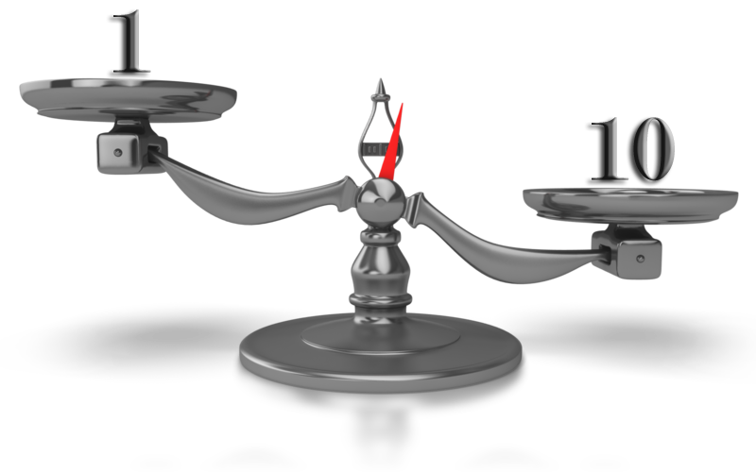
THE GOSPEL Step 3
On a Scale from 1-10…How good is God?
Of course…a 10!
Mark 10:18 “No one is good except God alone.”

Slide 7

THE GOSPEL Step 4
God knew the greatest need of humanity was to find meaning, value, and worth in their life and He decided to solve this problem!
IMAGINE IF…You had God’s goodness! Would you need to keep trying to
find your value in other people or in your career etc. ?
God loves you and wants to give you His goodness! But…
1 John 3:1 See how great a love the Father has bestowed on us, that we would be called children of God; and such we are.

Slide 8

THE GOSPEL Step 5
THE PROBLEM…
Although God Loves You...You don’t deserve His Love! Why? Because as we decided earlier you are born trying to find our goodness.
God is LOVING and JUST
What would you think of God if he let the Boston bomber out of jail because he loved him?
That would make God a crazy God!

Slide 9

THE GOSPEL Step 6
What if the country that wanted Boston bomber released
1. Paid off the national debt or
2. Released a US citizen from their country or
3. Exchanged someone for the bomber to be punished?
Would that be more just?
Although humanity deserves to be punished for our sin, God decided justice would be served if He took the punishment instead of us by coming to earth (in the form of a man named Jesus) and allowing Himself to be killed instead of us!
2 Corinthians 5:21: He made Him who knew no sin to be sin on our behalf, so that we might become the righteousness of God in Him.

Slide 10

THE GOSPEL Step 7
We have 3 parts…
Now God can give us His goodness because it is the LOVING and JUST thing to do…But how do we get His goodness!
body
mind
spirit
God is all THREE
God
Holy
Spirit
Jesus
1 Thessalonians 5:23: Now may the God of peace Himself sanctify you entirely; and may your spirit and soul (mind) and body be preserved complete.

Slide 11
THE GOSPEL Step 8
body
1. What part of you goes to heaven?
mind
2. How good is the Holy Spirit IF God’s
Spirit is in your spirit on a scale of 1-10?
spirit
3. Then what does that make you?
Holy
Spirit?
God
Holy
Spirit
Jesus
Romans 8:16: The Spirit Himself testifies with our spirit that we are children of God.
Rom. 8:9b “If anyone does not have the Spirit of Christ, he does not belong to Him.”

Slide 12
THE GOSPEL Step 9
body
How Does the Holy Spirit get in me?
mind
It is a GIFT
spirit
How do you obtain the GIFT?
Holy
Spirit?
God
Holy
Spirit
Jesus
Romans 5:17: …those who
Receive the abundance of grace and of the gift of righteousness (God’s goodness) will reign in life though the One, Jesus Christ

Slide 13

THE GOSPEL Step 10
Read the following verse aloud…
Romans 3:21: “But now apart from the Law (performance or other’s opinions) the righteousness (goodness) of God has been manifested
Do you have to perform or have other people’s good opinion
To get God’s righteousness (goodness)?

Slide 14
THE GOSPEL Step 11
Read the following verse aloud…
Romans 3:22: Even the righteousness of God through faith in Jesus Christ for all those who believe.
How do you get the righteousness of God?
Who gets the righteousness of God?

Slide 15
THE GOSPEL Step 12
body
Have you ever accepted the gift of God’s righteousness?
mind
spirit
Would you like to accept the gift of God’s righteousness?
Holy
Spirit
GIFT
God
Holy
Spirit
Jesus
Would you like to let God know you believe and have accepted His gift?

Slide 16
THE GOSPEL SUMMARY
Step 1: The BRIDGE Questions – Where is Your Worth?
Step 2: Why do we find our worth outside of ourselves?
Step 3: How Good is God? 1-10?
Step 4: Imagine if you had God’s goodness?
Step 5: The Problem – We don’t deserve it ☹.
Step 6: Justice had to be served.
Step 7: We have three parts.
Step 8: God is three persons.
Step 9: God’s righteousness is a Gift.
Step 10: Romans 3:21 – God’s righteousness apart from the Law.
Step 11: Romans 3:22 – Righteousness comes through faith.
Step 12: Have you accepted the gift of God’s goodness?

